Slide 1



Track Trends
Analyser
Real-Time Music Analytics & Performance Dashboard
PRESENTED BY :
25071A6214
25071A6215
25071A6220
25071A6223
Department of Computer Science - CYBER SECURITY

Slide 2

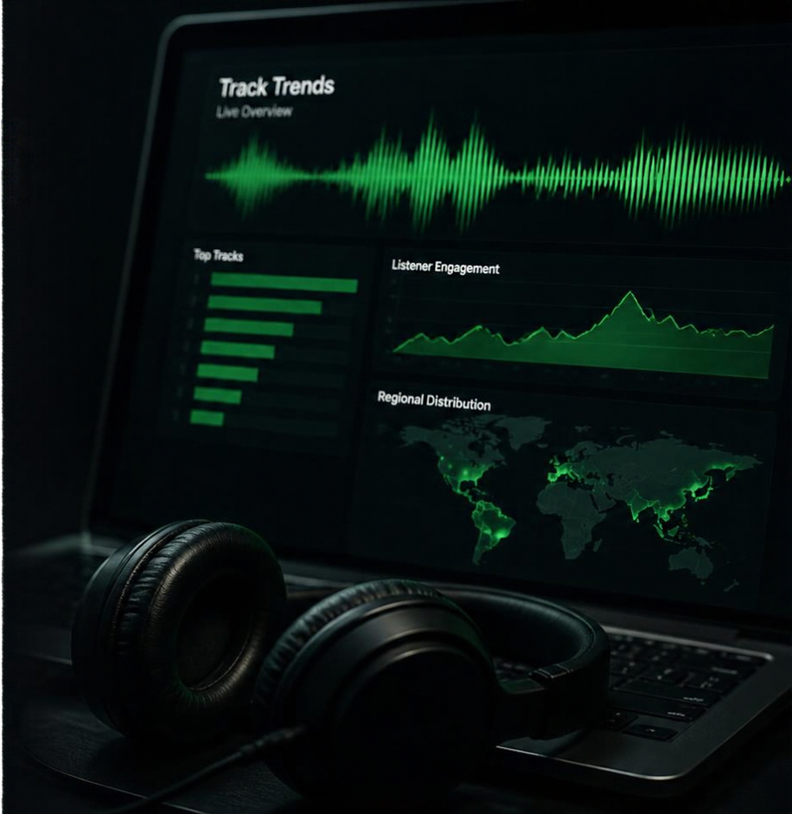
Introduction &
Motivation
Real-time analytics turns streaming data into immediate, actionable insights.
Track music trends as they happen
Move beyond static CSVs to live API data
Understand popularity, engagement, and reach
Make faster, smarter decisions with up-to-date insights

Slide 3









System Architecture & Workflow
A real-time pipeline that connects Spotify data to interactive performance insights.
DATA SOURCE
BACKEND MIDDLEWARE
CLIENT APPLICATION
Spotify Web API
Node.js / Express
Browser Client
Streams music, track,
and artist data in real time
Handles OAuth 2.0 tokens and API requests
Renders interactive charts with Chart.js
BACKEND TECHNOLOGIES
FRONTEND TECHNOLOGIES
Node.js
Express.js
Axios
Dotenv
HTML5
CSS3 (dark theme)
Vanilla JS ES6+
Chart.js (radar and bar charts)

Slide 4

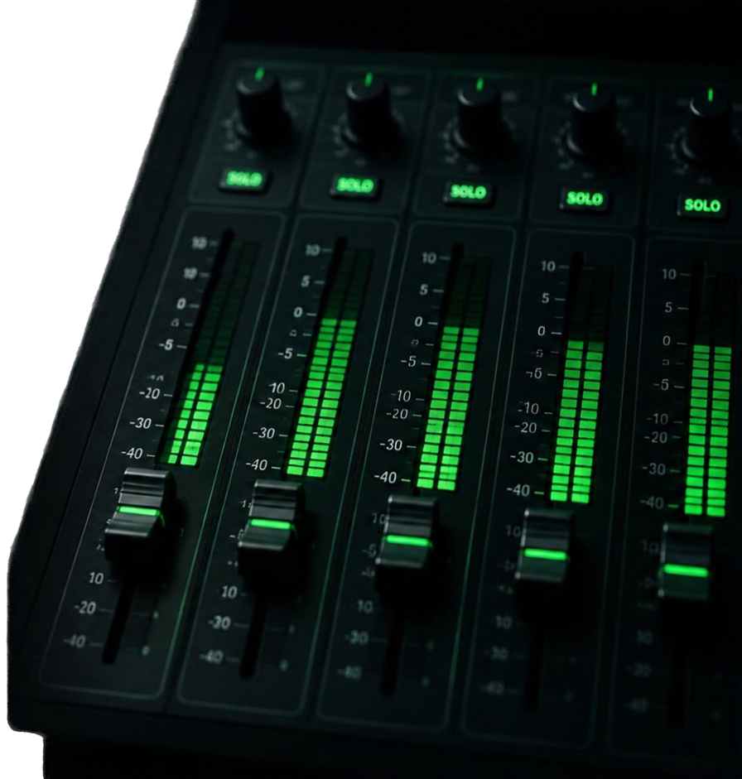





Key Metrics & Acoustic Features
0–100
Popularity Index
dynamic measure of track reach
Live
Estimated Listeners
real-time global audience estimate
Ratio
Audience Engagement
interaction metric
BPM
Tempo
beats per minute
Traits
Acoustic Audio Traits
danceability, energy, valence, acoustness

Slide 5











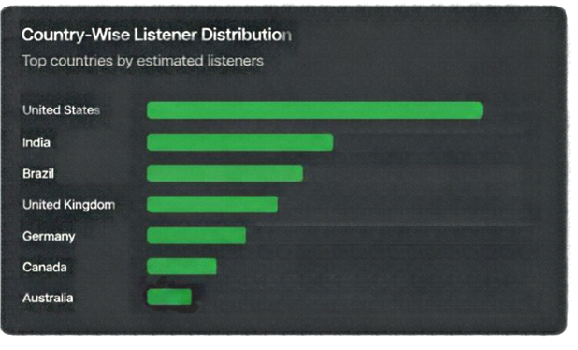















Dashboard
User Interface
A real-time view of track performance and audience insights.
TRACK TRENDS ANALYSER
Track Performance Dashboard
Connected to Spotify Web API
Search
Cruel Summer
Estimated Listeners
Total Likes
Tempo
Taylor Swift
Real-time Estimate
Favorite Ratio
BPM
Taylor Swift
Search
Lover
1.28M
78%
172
92
Popularity
Live Tracks
Cruel Summer
Country-Wise Listener Distribution
Audio Characteristics Profile
Anti-Hero
Track audio feature overview
All Too Well (10 Min Version)
Danceability
Blank Space
Energy
Liveness
Shake It Off
Brazil
Style
Love Story
Valence
Wildest Dreams
Canada
Instrumentalness
Acoustness

Slide 6











Visualizations &
Analytics Breakdown
Key dashboard visuals that reveal track mood and audience reach.
Audio Characteristics
Danceability
Listener Distribution
US
Radar Chart
Bar Chart
UK
Summarizes the track's key audio attributes to reveal its overall mood.
Shows where listeners are coming from to highlight regional popularity.
India
Acoustiness
Energy
Brazil
Germany
Rest of World
Valence
0%
10%
20%
30%
40%
Radar chart captures how the track sounds and feels.
Bar chart shows who is listening and where.

Slide 7



Technical Challenges & Engineering Solutions
CHALLENGE
SOLUTION
Managing asynchronous
OAuth 2.0 token lifecycle
Automated token refresh ensures uninterrupted access
Handling Spotify API
rate limits gracefully
Smart throttling and
fallback strategies
Real-time synchronization
for live dashboard updates
Optimized streaming pipeline keeps data in sync
Restricted endpoints risk downtime
Server fallbacks maintain
100% uptime

Slide 8






Conclusion &
Future Roadmap
Live track previews
Spotify Web Playback SDK
Playlist batch analysis
We built a live, interactive music analytics dashboard powered by real-time Spotify data.
Deeper audience insights
It delivers timely insights into track performance, audience engagement, and global reach.
Predictive models
Next, we’re expanding with live playback,
playlist analysis, and predictive models.
Hit-song prediction
Questions and feedback welcome.

